Slide 1




^{Python for Time Series}
^{(supplementary material)}
Prepared by: Dr Nick Lim
Presented by: Dr Guilherme Cassales
21st June 2023

Slide 2
Overview
Pandas: (~30 mins)
Reading data from CSV file
Inspecting Data Frame
Identifying Missing Data
Handling Missing Data
Viewing column statistics, plotting column values
Addressing values in dataframe
Processing columns - deriving new columns

Slide 3
Contents (cont.)
Advanced Pandas: (~20 mins)
Indexing / Reindexing (with specific focus on time index)
Resampling, rolling sums, interpolation
Group by, and Pivot tables/sub-tables
Colab notebook: https://shorturl.at/qX348

Slide 4
Useful python libraries
Pandas : a data processing library that is used for tabular data.
Matplotlib : a basic python plotting library for visualization, while not as powerful at other libraries, matplotlib provides the foundation for these other libraries.
Seaborn: a more powerful library for data visualization. It has in-built pandas support
Numpy: a foundational library for mathematical and matrix operations.

Slide 5
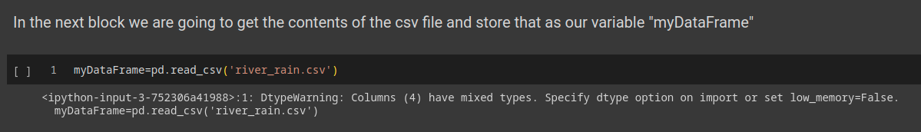
Reading csv files
https://pandas.pydata.org/pandas-docs/version/1.5/reference/api/pandas.read_csv.html

Slide 6
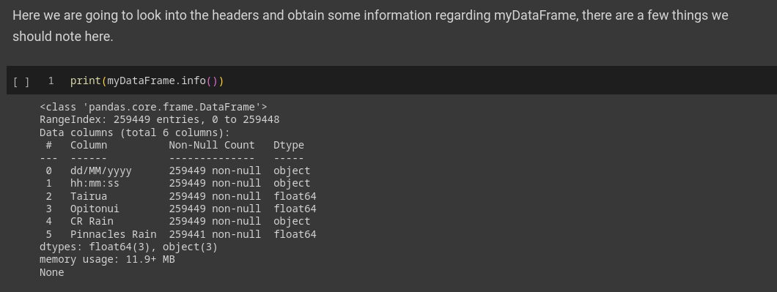
Information on the dataframe

Slide 7
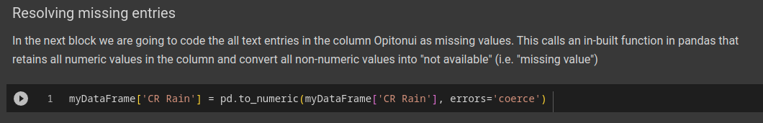
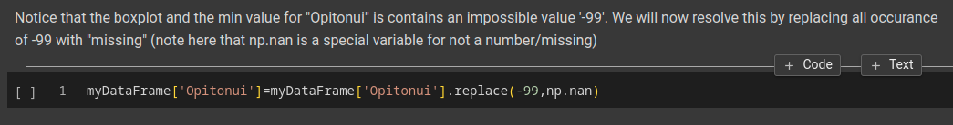
Handling Missing values
https://pandas.pydata.org/pandas-docs/version/1.5/reference/api/pandas.to_numeric.html
https://pandas.pydata.org/pandas-docs/version/1.5/reference/api/pandas.DataFrame.replace.html

Slide 8
Handling missing values (cont)
https://pandas.pydata.org/pandas-docs/version/1.5/reference/api/pandas.DataFrame.dropna.html
https://pandas.pydata.org/pandas-docs/version/1.5/reference/api/pandas.DataFrame.fillna.html

Slide 9
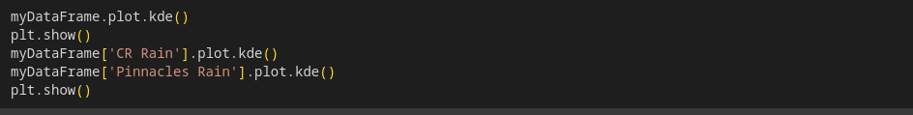
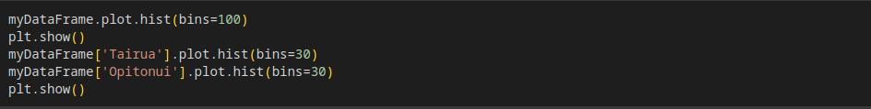
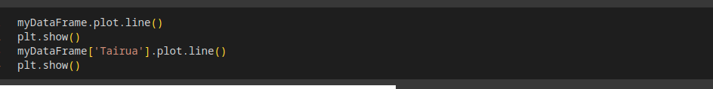
Plotting data
https://pandas.pydata.org/pandas-docs/version/1.5/reference/api/pandas.DataFrame.plot.kde.html
https://pandas.pydata.org/pandas-docs/version/1.5/reference/api/pandas.DataFrame.plot.line.html
also look at
https://seaborn.pydata.org/generated/seaborn.scatterplot.html

Slide 10
Deriving new columns

Slide 11
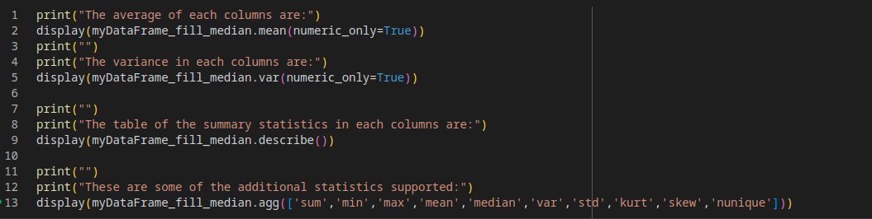
Summary Statistics
Also look at mode, quantile, corr, corrwith, value_counts, prod,

Slide 12


Addressing values in the dataframe

Slide 13
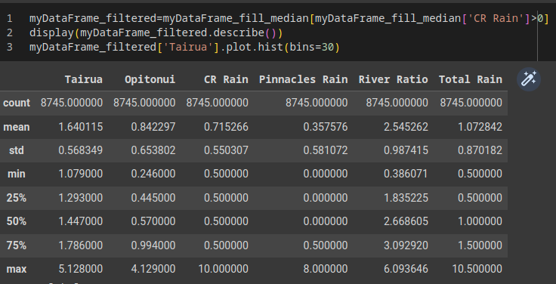
Subsetting the dataframe by condition

Slide 14
Advanced Pandas

Slide 15
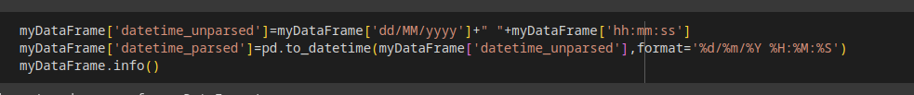
Converting text to timestamps
https://pandas.pydata.org/pandas-docs/version/1.5/reference/api/pandas.to_datetime.html

Slide 16
Using timestamp as index

Slide 17
Interpolating data
https://pandas.pydata.org/pandas-docs/version/1.5/reference/api/pandas.DataFrame.interpolate.html

Slide 18
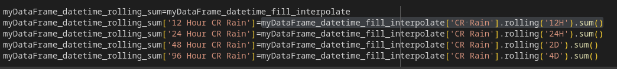
Rolling Sums, means, etc…
https://pandas.pydata.org/pandas-docs/version/1.5/reference/api/pandas.DataFrame.rolling.html

Slide 19
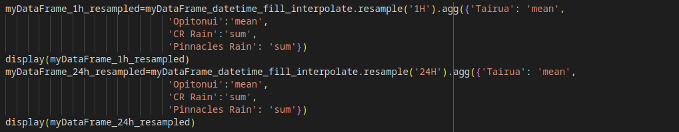
Resampling
https://pandas.pydata.org/pandas-docs/version/1.5/reference/api/pandas.DataFrame.resample.html

Slide 20
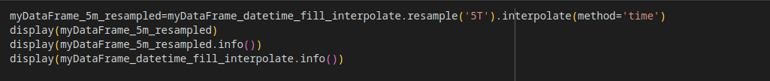
Resampling (cont.)

Slide 21
Group by
https://pandas.pydata.org/pandas-docs/version/1.5/reference/api/pandas.DataFrame.groupby.html
Also look at
https://pandas.pydata.org/pandas-docs/version/1.5/reference/api/pandas.DataFrame.pivot_table.html
https://pandas.pydata.org/pandas-docs/version/1.5/reference/api/pandas.DataFrame.pivot.html

Slide 22
Shifting
https://pandas.pydata.org/pandas-docs/version/1.5/reference/api/pandas.DataFrame.shift.html

Slide 23
Helpful links
https://pandas.pydata.org/docs/reference/api/pandas.Series.autocorr.html
https://seaborn.pydata.org/api.html
https://pandas.pydata.org/docs/reference/index.html
https://images.datacamp.com/image/upload/v1676302204/Marketing/Blog/Pandas_Cheat_Sheet.pdf
https://campus.datacamp.com/courses/python-for-r-users/pandas?ex=11

